Slide 1
Direction Detection of Select Stocks with Machine Learning
4th International Conference on Recent Trends in Communication & Intelligent Systems(ICRTCIS 2023)
Anand Mohan
Dr. Rashmi Agarwal
Dr. J.B Simha
RACE, REVA Academy for Corporate Excellence REVA University
PaperID:180
Date: 29/04/2023

Slide 2
Introduction
4th International Conference on Recent Trends in Communication & Intelligent Systems(ICRTCIS 2023)
Stock Market is a significant financial tool to raise funds.
Conventionally Fundamental and Technical analysis is usually done. Then Algorithmic trading is commonly used approach to evaluate stocks.
Stock Market Prediction using Machine learning is becoming one of the popular ways of identifying trends and directions to prevent losses due to volatility issues.

Slide 3
Literature Review
4th International Conference on Recent Trends in Communication & Intelligent Systems(ICRTCIS 2023)
28 Research articles were reviewed for capstone 2.some of the important papers are listed here.
No. | Title | Author and Year | Journal | Description | Insights
1 | The Effect of Using Technical and Fundamental Analysis | B. Elbialy, 2019 | International Journal of Applied Engineering Research | Fundamental analysis is being researched. | Fundamental analysis helps to identify stock quality .
2 | Analysis and Evaluation of Technical Indicators for Prediction of Stock Market | G. Thanekar, Z.Shaikh, 2021 | International Journal of Engineering Research & Technology (IJERT) | Technical analysis is being researched. | Technical Analysis examine volume and price action movements.
3 | machine learning models in algorithmic trading | K.Hansen, 2020 | Big Data and Society | Algorithms improve traders’ ability to scan the market and seize opportunities most appropriately | regulators have restrained algorithmic trading following accusations of market manipulations
4 | Forecasting stock market prices : A machine learning approach | A.Alhomadi, 2021 | Digital Commons | Machine learning algorithms are researched. | Both supervised and unsupervised machine learning techniques create predictions with satisfactory accuracy

Slide 4
Literature Review
4th International Conference on Recent Trends in Communication & Intelligent Systems(ICRTCIS 2023)
Research Gaps observed:
Feature expansion and elimination techniques were rarely done.
Hyper parameter tuning to optimize modelling accuracy were missing..
Regression based prediction models are getting mostly researched but direction based analysis applying Unique Feature Engineering and Experimenting with Modelling approaches were rarely available .

Slide 5
Problem Statement
4th International Conference on Recent Trends in Communication & Intelligent Systems(ICRTCIS 2023)
Plenty of algorithms that detect the exact closing price of any stock but will not analyze direction
of the stock movements.
Therefore, classification based Modelling algorithms is being applied for direction detection applying Unique Feature Engineering and different Modelling approaches.

Slide 6
Project Objectives
4th International Conference on Recent Trends in Communication & Intelligent Systems(ICRTCIS 2023)
1.Explore the data and
prepare the data to make it
suitable to get utilized
in Modelling algorithms.
2.Build the right models
by using multiple
Classification Modelling
techniques .
3. minimize errors
in direction prediction.

Slide 7
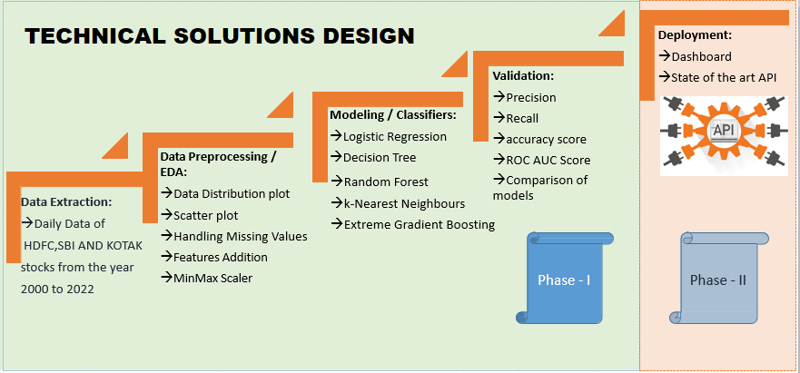
Project Methodology
4th International Conference on Recent Trends in Communication & Intelligent Systems(ICRTCIS 2023)

Slide 8
Business Understanding
4th International Conference on Recent Trends in Communication & Intelligent Systems(ICRTCIS 2023)
Stocks Fundamental Analysis
Stocks Technical Analysis
Particulars | HDFC | KOTAK | SBI
Adjusted EPS(Rs.) | 67 | 43 | 35
Net Profit | 369 | 85 | 316
Total Liabilities | 20685 | 4294 | 49875
Total Assets | 20685 | 4294 | 49875
Closing Cash | 1553 | 526 | 3989
Technical Indicators | HDFC | KOTAK | SBI
RSI | 52(N) | 39(BR) | 50(N)
MACD | 35(BU) | -13(BR) | -1(BR)
Stochastic | 56(BU) | 10(OS) | 64(BU)
ADX | 21(W) | 20(W) | 27(S)
All figures in Fundamental Analysis except Adjusted EPS are in Billions for the financial year 2022-2023.
All positions in Technical indicators are weekly trends as recorded on 10/3/2023
RS1 and Stochastic are Momentum indicators.
ADX and MACD are Trend indicators.
N indicates Neutral; BU indicates Bullish; BR indicates Bearish; W indicates Weak Trend; S indicates Strong Trend; OS-Over Sold

Slide 9
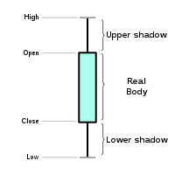
Data Understanding
4th International Conference on Recent Trends in Communication & Intelligent Systems(ICRTCIS 2023)
Date | Symbol | Prev Close | Open | High | Low | Last | VWAP | Volume (1000’s) | Close
1/3/2000 | HDFC | 272 | 294 | 294 | 294 | 294 | 294 | 23 | 294
5/30/2022 | HDFC | 2330 | 2368 | 2388 | 2362 | 2367 | 2376 | 5424 | 2367
1/3/2000 | KOTAK | 212 | 220 | 229 | 220 | 229 | 229 | 7 | 229
5/30/2022 | KOTAK | 1946 | 1945 | 1952 | 1896 | 1907 | 1921 | 3988 | 1903
1/3/2000 | SBI | 226 | 236 | 244 | 234 | 244 | 241 | 2373 | 244
5/30/2022 | SBI | 469 | 473 | 477 | 471 | 475 | 474 | 9365 | 475
The previous close nearly always refers to the previous day's final price.
The last price is the one at which the foremost recent transaction happens.
volume-weighted average worth (VWAP) represents the typical price listed throughout the day based on both volume and worth.
Volume and Share turnover is an estimation of stock liquidity.

Slide 10
Data Preparation
4th International Conference on Recent Trends in Communication & Intelligent Systems(ICRTCIS 2023)
Missing Values | MinMaxScaler | Feature Engineering
'Trades', 'Deliverable Volume', and'% Deliverable' had more than 100 missing values. Hence, those columns were dropped. | MinMax Scaler shrinks the data inside the given range in this project i.e. from zero to one. It scales the price to a selected value range while not varying the form of the initial distribution. | Newly Added Feature Variables: 13 days, 20 days, 100 days, 200 days Rolling Windows based Simple moving averages. 13 days, 20 days, 100 days, 200 days exponential moving averages 1 day's previous lag values of volume. 6, 10, 14 and 30 days consecutive closing prices are tabulated week on week for the entire dataset . Momentum indicators Trend indicators Volatility indicators Volume indicators

Slide 11
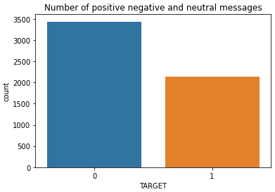
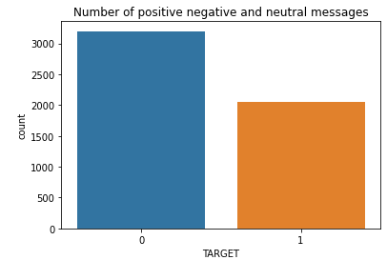
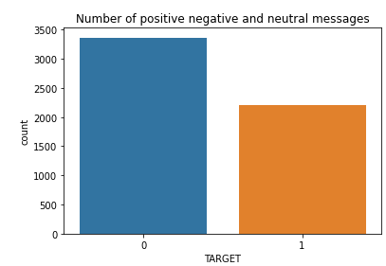
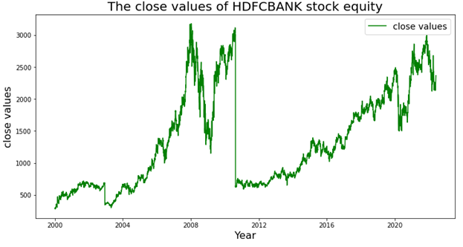
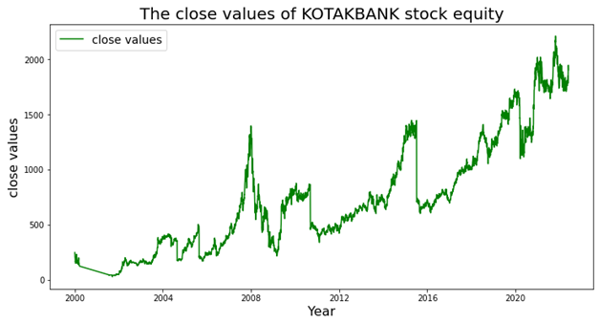
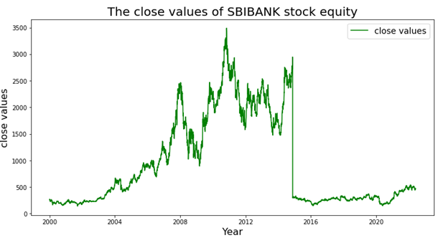
Descriptive Analytics
4th International Conference on Recent Trends in Communication & Intelligent Systems(ICRTCIS 2023)
class distribution For HDFC, KOTAK, and SBI stock
Close values of HDFCBANK, KOTAK BANK, and SBIBANK stock from 2000 to 2022

Slide 12
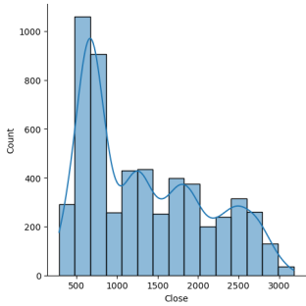
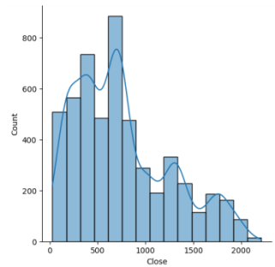
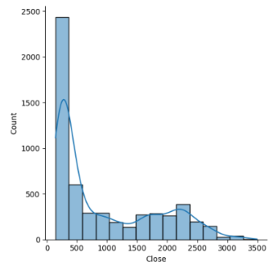
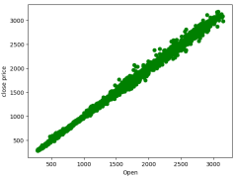
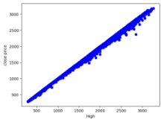
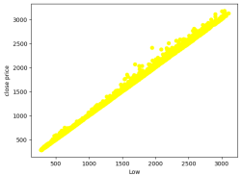
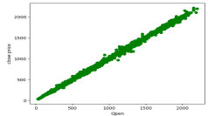
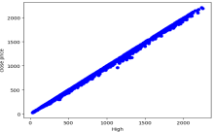
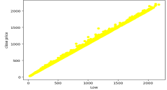
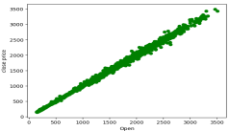
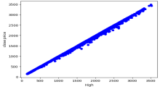
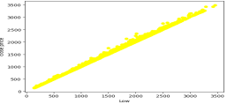
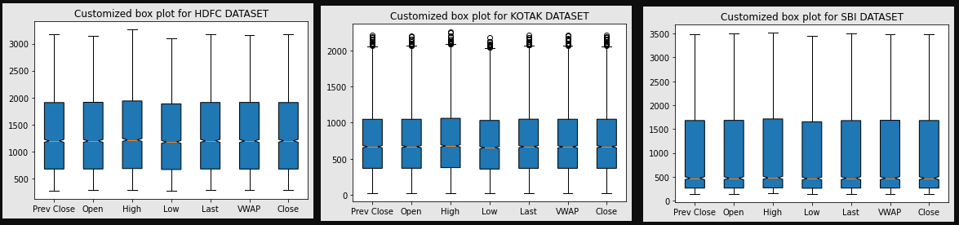
Descriptive Analytics
4th International Conference on Recent Trends in Communication & Intelligent Systems(ICRTCIS 2023)
HDFC | KOTAK | SBI
Density plot shows positive skewed distribution.
KOTAK has highest volatility.
linear relationship exists between Independent variables and the Target variable.

Slide 13
Modeling
4th International Conference on Recent Trends in Communication & Intelligent Systems(ICRTCIS 2023)
Modelling Strategies | Model Evaluation Rule
Direction Detection by 6,10,14 days consecutive closing prices split week on the week. | percentage change on closing price>0.7% ➔Positive Trend percentage change on closing price<-0.7% ➔Negative Trend percentage change on closing price between 0.7 and 0.7% ➔Neutral
Go Long Direction Prediction performed separately using Momentum, Trend, Volatility and Volume Indicators | percentage change on closing price>0.5% ➔Positive Trend percentage change on closing price<=0.5% ➔Not Positive Trend
Classification Models used:
Logistic Regression
Decision Tree using Grid SearchCV and Cross Validation
Random Forest using Randomized SearchCV and Cross Validation
K Nearest Neighbours
XG Boost

Slide 14
Model Evaluation
4th International Conference on Recent Trends in Communication & Intelligent Systems(ICRTCIS 2023)
Logistic
Regression
Modelling Algorithms | HDFC | KOTAK | SBI
Go Long Direction Prediction using Volume Indicators | precision-0.98 recall-0.83 accuracy-0.92 | precision-0.99 recall-0.93 accuracy-0.97 | precision-0.92 recall-0.80 accuracy-0.90
Go Long Direction Prediction using Momentum Indicators | precision-0.71 recall-0.63 Accuracy-0.76 | precision-0.73 recall-0.61 accuracy-0.75 | precision-0.69 recall-0.62 accuracy-0.74
Go Long Direction Prediction using Trend Indicators | precision-0.83 recall-0.59 Accuracy-0.80 | precision-0.76 recall-0.48 accuracy-0.72 | precision-0.78 recall-0.49 accuracy-0.74
Highest precision, recall and accuracy in Direction Prediction given by Logistic Regression using volume indicators and suggested for high risk investors.
Random
Forest
Modelling Algorithms | HDFC | KOTAK | SBI
Direction Detection by 6,10,14 days consecutive closing prices split week on the week | precision-0.85 recall-0.89 accuracy-0.87 | Precision-0.71 recall-0.79 accuracy-0.74 | Precision-0.83 recall-0.88 accuracy-0.85
Go Long Direction Prediction using Volume Indicators | precision-0.93 recall-0.69 accuracy-0.85 | precision-0.92 recall-0.79 accuracy-0.89 | precision-0.90 recall-0.73 accuracy-0.86
Go Long Direction Prediction using Momentum Indicators | precision-0.76 recall-0.51 Accuracy-0.75 | precision-0.78 recall-0.50 accuracy-0.75 | precision-0.72 recall-0.55 accuracy-0.74
Modelling Algorithms | HDFC | KOTAK | SBI
Go Long Direction Prediction using Volume Indicators | precision-0.90 recall-0.73 accuracy-0.86 | precision-0.92 recall-0.87 accuracy-0.92 | precision-0.88 recall-0.82 accuracy-0.89
Go Long Direction Prediction using Trend Indicators | precision-0.85 recall-0.65 Accuracy-0.82 | precision-0.82 recall-0.61 accuracy-0.79 | precision-0.83 recall-0.67 accuracy-0.81
Go Long Direction Prediction using Volatility Indicators | precision-0.84 recall-0.69 Accuracy-0.82 | precision-0.81 recall-0.63 accuracy-0.79 | precision-0.80 recall-0.67 accuracy-0.81
XG Boost
 | HDFC | KOTAK | SBI
Direction Detection by 6,10,14 days consecutive closing prices split week on the week (RF Classifier ) | precision-0.85 recall-0.89 accuracy-0.87 | Precision-0.71 recall-0.79 accuracy-0.74 | Precision-0.83 recall-0.88 accuracy-0.85
Go Long Direction Prediction using Volume Indicators (LR Classifier ) | precision-0.98 recall-0.83 accuracy-0.92 | precision-0.99 recall-0.93 accuracy-0.97 | precision-0.92 recall-0.80 accuracy-0.90
Go Long Direction Prediction using Momentum Indicators (LR Classifier ) | precision-0.71 recall-0.63 Accuracy-0.76 | precision-0.73 recall-0.61 accuracy-0.75 | precision-0.69 recall-0.62 accuracy-0.74
Go Long Direction Prediction using Trend Indicators (XG Boost Classifier ) | precision-0.85 recall-0.65 Accuracy-0.82 | precision-0.82 recall-0.61 accuracy-0.79 | precision-0.83 recall-0.67 accuracy-0.81
Go Long Direction Prediction using Volatility Indicators (XG Boost Classifier ) | precision-0.84 recall-0.69 Accuracy-0.82 | precision-0.81 recall-0.63 accuracy-0.79 | precision-0.80 recall-0.67 accuracy-0.81

Slide 15
Results and Insights
4th International Conference on Recent Trends in Communication & Intelligent Systems(ICRTCIS 2023)
Modelling Methods | HDFC | KOTAK | SBI
Direction Detection by 6,10,14 days consecutive closing prices split week on the week (RF Classifier ) | precision-0.85 recall-0.89 accuracy-0.87 | Precision-0.71 recall-0.79 accuracy-0.74 | Precision-0.83 recall-0.88 accuracy-0.85
Go Long Direction Prediction using Volume Indicators (LR Classifier ) | precision-0.98 recall-0.83 accuracy-0.92 | precision-0.99 recall-0.93 accuracy-0.97 | precision-0.92 recall-0.80 accuracy-0.90
Go Long Direction Prediction using Momentum Indicators (RF Classifier ) | precision-0.76 recall-0.51 Accuracy-0.75 | precision-0.78 recall-0.50 accuracy-0.75 | precision-0.72 recall-0.55 accuracy-0.74
Go Long Direction Prediction using Trend Indicators (XG Boost Classifier ) | precision-0.85 recall-0.65 Accuracy-0.82 | precision-0.82 recall-0.61 accuracy-0.79 | precision-0.83 recall-0.67 accuracy-0.81
Go Long Direction Prediction using Volatility Indicators (XG Boost Classifier ) | precision-0.84 recall-0.69 Accuracy-0.82 | precision-0.81 recall-0.63 accuracy-0.79 | precision-0.80 recall-0.67 accuracy-0.81
Leader Board showing highest prediction accuracy for each of the different Modelling Methods.

Slide 16
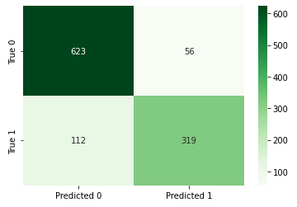
Utility from Business perspectives
4th International Conference on Recent Trends in Communication & Intelligent Systems(ICRTCIS 2023)
Using trend indicators with the highest precision of 0.85 for HDFCBANK stock, the confusion matrix provides information as shown
If we Invest Rs.10000 for 6 years for 0.5% change on close price, Net returns is estimated as:
18.63%

Slide 17
Risk-Adjusted Returns
4th International Conference on Recent Trends in Communication & Intelligent Systems(ICRTCIS 2023)
Sharpe ratios are calculated as:
HDFC=>0.17
KOTAK=>0.15
SBI=>0.01
HDFC has the highest Sharpe ratios which means it gives the highest returns with the least risk possible.
stop loss of 2.0=>reward to risk ratio for approximate 0.8 Precision would be 2*.8/2*.2=4:1
if 0.5% difference in consecutive day close price for any stock is only 2.0.for higher percentage difference than 0.5% reward to risk ratio would be higher.

Slide 18
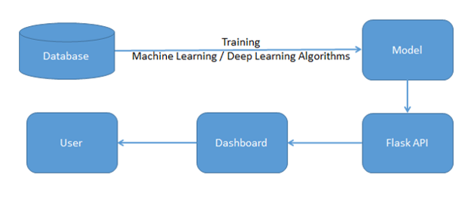
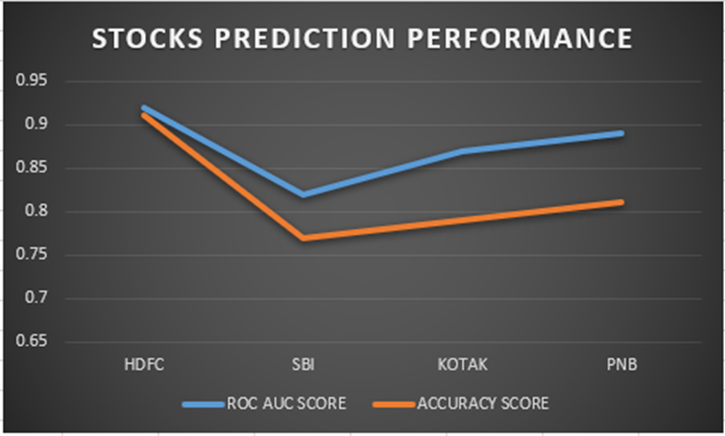
Model Deployment
4th International Conference on Recent Trends in Communication & Intelligent Systems(ICRTCIS 2023)
As per the proposal for future assignments, the dashboard takes API as an input Derived from the machine/deep learning algorithms for multi-label features with an end-to-end User Interface.

Slide 19
Conclusion and Future Scope
4th International Conference on Recent Trends in Communication & Intelligent Systems(ICRTCIS 2023)
Any stock on the stock market can utilize the same procedure as defined in this project to forecast buy or sell choices, which is helpful.
Intelligent Automated system on Options Trading would be the next step forward.
In the Future, there is a deployment Dashboard proposed.
In future projects, it can be shown how to define Bullish and Bearish regimes using modern machine learning techniques.
The Sentiment Analysis Approach may also be explored using Text Analytics for predicting stock market returns.

Slide 20
Conclusion and Future Scope
4th International Conference on Recent Trends in Communication & Intelligent Systems(ICRTCIS 2023)
Currently Direction Detection is based on current day and previous day. Different approaches is 6th day,10th day and 14th day. Percentage change estimated were 0.5% change,1% change and 1.5% change between 7th-8th day,11th-12th day and 15th-16th day.
Implementation of direction detection between current 30 minutes and previous 30 minutes for the same day can be done. Stock market is opened for 6 hours in a day. Different approaches would be 4th 30 minutes, 8th 30 minutes and 10th 30 minutes. Percentage change estimated would be 0.2% change,0.4% change and 0.6% change between 5th-6th 30 min.,9th-10th 30 min. and 11th-12th 30 min.
Also, stocks researched were only 3 NSE stocks. Scalable implementation would be all 6500 stocks from BSE AND NSE-India,2400 Stocks from New York Stock Exchange-United States,3000 Stocks from NASDAQ-United States,1600 Stocks from Shanghai Stock Exchange-China,1500 Stocks from EURONEXT- Europe,1500 Stocks from Japan Stock Exchange-Japan,2200 Stocks from Honk Kong Stock Exchange.
The combined data from all these datasets would be more than 100 GBs of data. There can be two approaches to handle more than 100 GBs of data. One would be Dask clusters(medium sized) preferably on data bricks.Other would be data bricks spark clusters.

Slide 21
References
4th International Conference on Recent Trends in Communication & Intelligent Systems(ICRTCIS 2023)
Al-Bairmani, Z. A. A., & Ismael, A. A. (2021). Using Logistic Regression Model to Study the Most Important Factors Which Affects Diabetes for the Elderly in the City of Hilla / 2019. Journal of Physics: Conference Series, 1818(1). https://doi.org/10.1088/1742-6596/1818/1/012016
Alhomadi, A. (2021). Forecasting stock market prices : A machine learning approach. Digital Commons, 11(2), 16–36.
Anjani, T., & Syarif, A. D. (2019). The Effect of Fundamental Analysis on Stock Returns using Data Panels ; Evidence Pharmaceutical Companies listed on IDX. International Journal of Innovate Science and Research Technology, 4(7), 500–505.
Cornellius Yudha Wijaya. (2021). CRISP-DM Methodology For Your First Data Science Project. https://towardsdatascience.com/crisp-dm-methodology-for-your-first-data-science-project-769f35e0346c
Dahham, A. Z. D., & Ibrahim, A. A. (2020). Effects of Volatility and Trend Indicator for Improving Price Prediction of Cryptocurrency. IOP Conference Series: Materials Science and Engineering, 928(3). https://doi.org/10.1088/1757-899X/928/3/032043
Dar, A. N. (2021). PRINCIPAL COMPONENT ANALYSIS (PCA) (Using Eigen Decomposition). Gsj, 9(7), 240–252. www.globalscientificjournal.com
Elbialy, B. A. (2019). The Effect of Using Technical and Fundamental Analysis on the Effectiveness of Investment Decisions of Traders on the Egyptian Stock Exchange. International Journal of Applied Engineering Research, 14(24), 4492–4501. http://www.ripublication.com
Faijareon, C., & Sornil, O. (2019). Evolving and combining technical indicators to generate trading strategies. Journal of Physics: Conference Series, 1195(1). https://doi.org/10.1088/1742-6596/1195/1/012010
Hafeez, M. A., Rashid, M., Tariq, H., Abideen, Z. U., Alotaibi, S. S., & Sinky, M. H. (2021). Performance improvement of decision tree: A robust classifier using tabu search algorithm. Applied Sciences (Switzerland), 11(15). https://doi.org/10.3390/app11156728
Hansen, K. B. (2020). The virtue of simplicity: On machine learning models in algorithmic trading. Big Data and Society, 7(1). https://doi.org/10.1177/2053951720926558
Huang, Y., Capretz, L. F., & Ho, D. (2021). Machine Learning for Stock Prediction Based on Fundamental Analysis. 2021 IEEE Symposium Series on Computational Intelligence, SSCI
2021 - Proceedings. https://doi.org/10.1109/SSCI50451.2021.9660134
Jena, M., & Dehuri, S. (2020). Decision tree for classification and regression: A state-of-the art review. Informatica (Slovenia), 44(4), 405–420. https://doi.org/10.31449/INF.V44I4.3023
Kimbonguila, A., Matos, L., Petit, J., Scher, J., & Nzikou, J.-M. (2019). Effect of Physical Treatment on the Physicochemical, Rheological and Functional Properties of Yam Meal of the Cultivar “Ngumvu” From Dioscorea Alata L. of Congo. International Journal of Recent Scientific Research, 10, 30693–30695. https://doi.org/10.24327/IJRSR
Magner, N., Lavin, J. F., Valle, M., & Hardy, N. (2021). The predictive power of stock market’s expectations volatility: A financial synchronization phenomenon. PLoS ONE, 16(5 May), 1–21. https://doi.org/10.1371/journal.pone.0250846
Markoulidakis, I., Kopsiaftis, G., Rallis, I., & Georgoulas, I. (2021). Multi-Class Confusion Matrix Reduction method and its application on Net Promoter Score classification problem. ACM International Conference Proceeding Series, 412–419. https://doi.org/10.1145/3453892.3461323
Mohapatra, S., & Misra, A. K. (2020). Momentum returns: A portfolio-based empirical study to establish evidence, factors and profitability in Indian stock market. IIMB Management Review, 32(1), 75–84. https://doi.org/10.1016/j.iimb.2019.07.007
moneycontrol. (n.d.). HDFC Bank Ltd.TECHNICALS. https://www.moneycontrol.com/technical-analysis/hdfcbank/HDF01/weekly
Mukerji, P., Chung, C., Walsh, T., & Xiong, B. (2019). The Impact of Algorithmic Trading in a Simulated Asset Market. Journal of Risk and Financial Management, 12(2), 68. https://doi.org/10.3390/jrfm12020068
Omta, W. A., van Heesbeen, R. G., Shen, I., de Nobel, J., Robers, D., van der Velden, L. M., Medema, R. H., Siebes, A. P. J. M., Feelders, A. J., Brinkkemper, S., Klumperman, J. S., Spruit, M. R., Brinkhuis, M. J. S., & Egan, D. A. (2020). Combining Supervised and Unsupervised Machine Learning Methods for Phenotypic Functional Genomics Screening. SLAS Discovery, 25(6), 655–664. https://doi.org/10.1177/2472555220919345
Rajkar, A., Kumaria, A., Raut, A., & Kulkarni, N. (2021). Stock Market Price Prediction and Analysis. International Journal of Engineering Research & Technology, 10(06), 115–119.
Rouf, N., Malik, M. B., Arif, T., Sharma, S., Singh, S., Aich, S., & Kim, H. C. (2021). Stock
market prediction using machine learning techniques: A decade survey on methodologies, recent developments, and future directions. Electronics (Switzerland), 10(21). https://doi.org/10.3390/electronics10212717
Schonlau, M., & Zou, R. Y. (2020). The random forest algorithm for statistical learning. Stata Journal, 20(1), 3–29. https://doi.org/10.1177/1536867X20909688
Shah, D., Isah, H., & Zulkernine, F. (2019). Stock market analysis: A review and taxonomy of prediction techniques. International Journal of Financial Studies, 7(2). https://doi.org/10.3390/ijfs7020026
Silva, I., & Naranjo, J. E. (2020). A systematic methodology to evaluate prediction models for driving style classification. Sensors (Switzerland), 20(6), 1–21. https://doi.org/10.3390/s20061692
Sonkiya, P., Bajpai, V., & Bansal, A. (2021). Stock price prediction using BERT and GAN. http://arxiv.org/abs/2107.09055
Thanekar, G. S., & Shaikh, Z. S. (2021). Analysis and Evaluation of Technical Indicators for Prediction of Stock Market. International Journal of Engineering Research & Technology (IJERT), 10(May), 341–344.
Wang, L. (2019). Research and Implementation of Machine Learning Classifier Based on KNN. IOP Conference Series: Materials Science and Engineering, 677(5), 0–5. https://doi.org/10.1088/1757-899X/677/5/052038
Zhang, P., Jia, Y., & Shang, Y. (2022). Research and application of XGBoost in imbalanced data. International Journal of Distributed Sensor Networks, 18(6). https://doi.org/10.1177/15501329221106935

Slide 22
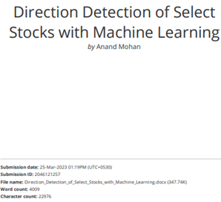
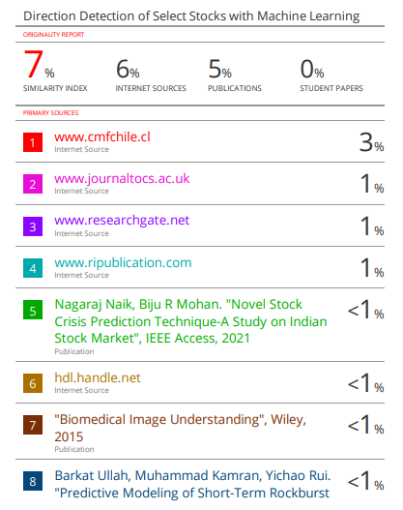
Annexure
4th International Conference on Recent Trends in Communication & Intelligent Systems(ICRTCIS 2023)
plagiarism report using
Turnitin Software shows 7% Similarity Index.

Slide 23
Annexure
4th International Conference on Recent Trends in Communication & Intelligent Systems(ICRTCIS 2023)
The implementation for the conference paper can be accessed at the link below:
https://github.com/Embedded-org/MBA-BUSINESS-ANALYTICS/tree/master/RACE_CAPSTONE_PROJECT2

Slide 24
Thank You!
4th International Conference on Recent Trends in Communication & Intelligent Systems(ICRTCIS 2023)

